Slide 1
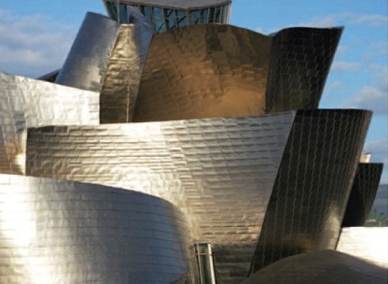
Computer Organization and Architecture Week 1 & 2

Slide 2
Computer Architecture
Computer Organization
Computer Architecture
Attributes of a system visible to the programmer
Have a direct impact on the logical execution of a program
Architectural attributes include:
Instruction set, number of bits used to represent various data types, I/O mechanisms, techniques for addressing memory
Computer Organization
The operational units and their interconnections that realize the architectural specifications
Organizational attributes include:
Hardware details transparent to the programmer, control signals, interfaces between the computer and peripherals, memory technology used
Many computer manufacturers offer a family of computer models, all with the same architecture but with differences in organization. Consequently, the different models in the family have different price and performance characteristics.

Slide 3
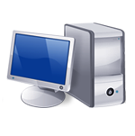
IBM System
370 Architecture
IBM System/370 architecture
Was introduced in 1970
Included a number of models
The customer with modest requirements could buy a cheaper, slower model and, if demand increased later upgrade to a more expensive, faster model without having to abandon original software
New models are introduced with improved technology, but retain the same architecture so that the customer’s software investment is protected
Architecture has survived to this day as the architecture of IBM’s mainframe product line

Slide 4
Structure and Function
A computer is a complex system; contemporary computers contain millions of Elementary electronic components. How, then, can one clearly describe them? The key is to recognize the hierarchical nature of most complex systems, including the computer
Hierarchical system
Set of interrelated subsystems
Hierarchical nature of complex systems is essential to both their design and their description
Designer need only deal with a particular level of the system at a time
Concerned with structure and function at each level
Structure
The way in which components relate to each other
Function
The operation of individual components as part of the structure

Slide 5
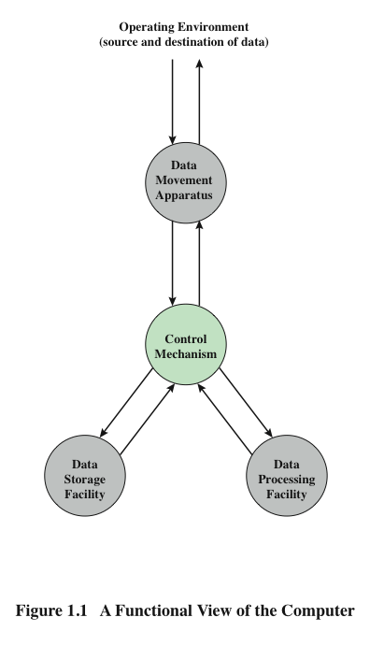
Function
Both the structure and functioning of a computer are, in essence, simple.
A computer can perform four basic functions:
Data processing
Data storage
Data movement
Control
The computer, of course, must be able to process data. The data may take a wide variety of forms, and the range of processing requirements is broad. However, we shall see that there are only a few fundamental methods or types of data processing.
Notes:
to those instructions.

Slide 6
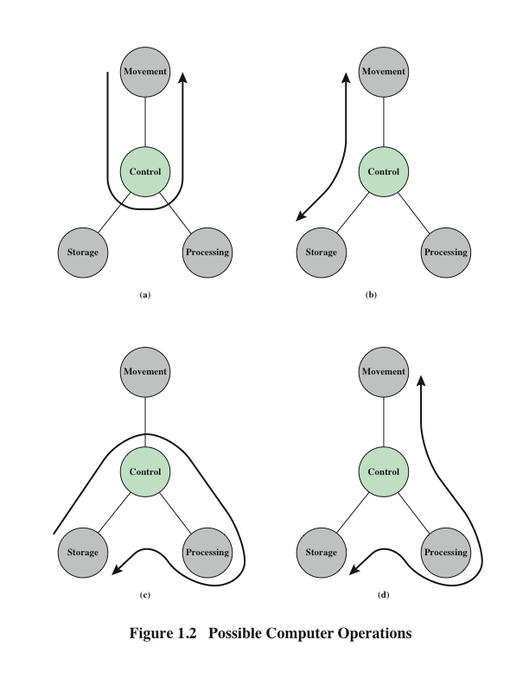
Operations (a) Data movement
The computer must be able to move data between itself and the outside world. The computer’s operating environment consists of devices that serve as either sources or destinations of data. When data are received from or delivered to a device that is directly connected to the computer, the process is known as input–output (I/O), and the device is referred to as a peripheral. When data are moved over longer distances, to or from a remote device, the process is known as data communications.

Slide 7
Operations (b) Data movement
Diagrams show operations involving data processing, on data either in storage

Slide 8
Operations (c) Data storage
It is also essential that a computer store data. Even if the computer is processing data on the fly (i.e., data come in and get processed, and the results go out immediately), the computer must temporarily store at least those pieces of data that are being worked on at any given moment. Thus, there is at least a short-term data storage function.

Slide 9
Operations (d) Control
There must be control of these three functions. Ultimately, this control is exercised by the individual(s) who provides the computer with instructions. Within the computer, a control unit manages the computer’s resources and orchestrates the
performance of its functional parts in response to those instructions.

Slide 10
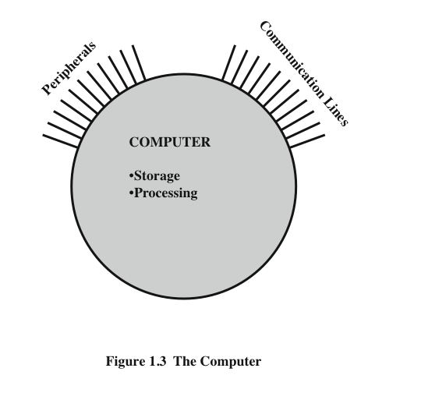
The Computer
interacts in some fashion with its external environment. In general, all of its linkages to the external environment can be classified as peripheral devices or communication lines.

Slide 11
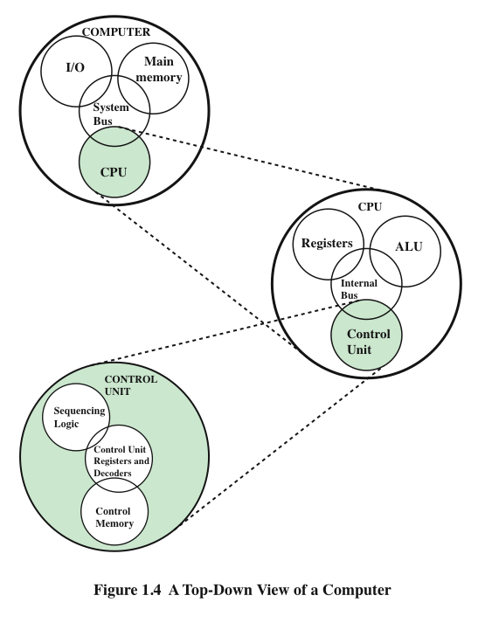
Structure

Slide 12
CPU – controls the operation of the computer and performs its data processing functions
Main Memory – stores data
I/O – moves data between the computer and its external environment
System Interconnection – some mechanism that provides for communication among CPU, main memory, and I/O.
A common example of system interconnection is by means of a system bus, consisting of a number of conducting wires to which all the other components attach.
There are four main structural components
of the computer:

Slide 13
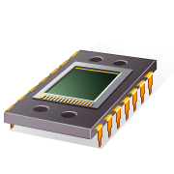
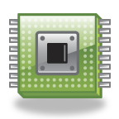
CPU
Control Unit
Controls the operation of the CPU and hence the computer
Arithmetic and Logic Unit (ALU)
Performs the computer’s data processing function
Registers
Provide storage internal to the CPU
CPU Interconnection
Some mechanism that provides for communication among the control unit, ALU, and registers
Major structural components:
Notes:
.

Slide 14
Computer Evolution and Performance
study of computers with a brief history

Slide 15
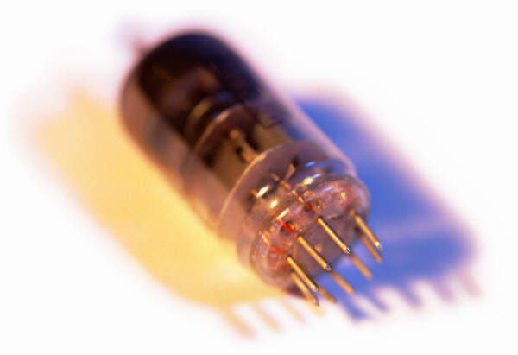
History of Computers
First Generation: Vacuum Tubes
ENIAC
Electronic Numerical Integrator And Computer
Designed and constructed at the University of Pennsylvania
Started in 1943 – completed in 1946
By John Mauchly and John Eckert
World’s first general purpose electronic digital computer
Army’s Ballistics Research Laboratory (BRL) needed a way to supply trajectory tables for new weapons accurately and within a reasonable time frame
Was not finished in time to be used in the war effort
Its first task was to perform a series of calculations that were used to help determine the feasibility of the hydrogen bomb
Continued to operate under BRL management until 1955 when it was disassembled

Slide 16
ENIAC
Weighed
30
tons
Occupied
1500
square
feet
of
floor
space
Contained
more
than
18,000
vacuum
tubes
140 kW
Power
consumption
Capable
of
5000
additions
per
second
Decimal
rather
than
binary
machine
Memory
consisted
of 20 accumulators,
each
capable
of
holding
a
10 digit
number
Major
drawback
was the need
for manual programming
by setting
switches
and
plugging/
unplugging
cables

Slide 17
John von Neumann
EDVAC (Electronic Discrete Variable Computer)
First publication of the idea was in 1945
Stored program concept
Attributed to ENIAC designers, most notably the mathematician John von Neumann
Program represented in a form suitable for storing in memory alongside the data
IAS computer
Princeton Institute for Advanced Studies
In 1946, von Neumann and his colleagues began the design of a new stored program computer
Prototype of all subsequent general-purpose computers
Completed in 1952

Slide 18
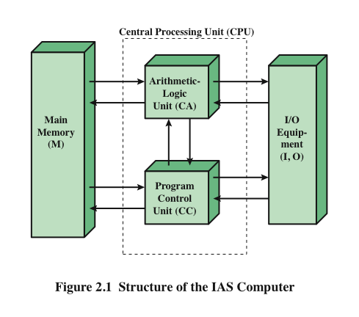
Structure of von Neumann Machine

Slide 19
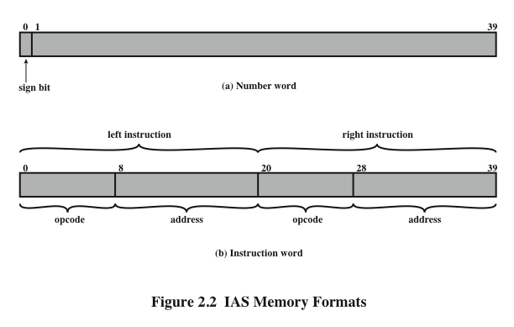
IAS Memory Formats
Both data and instructions are stored there
Numbers are represented in binary form and each instruction is a binary code
The memory of the IAS consists of 1000 storage locations (called words) of 40 bits each
Figure 2.2 illustrates these formats. Each number is represented by a sign bit and a 39-bit value. A word may also contain two 20-bit instructions, with each instruction Consisting of an 8-bit operation code (opcode) specifying the operation to be Performed and a 12-bit address designating one of the words in memory (numbered from 0 to 999).

Slide 20
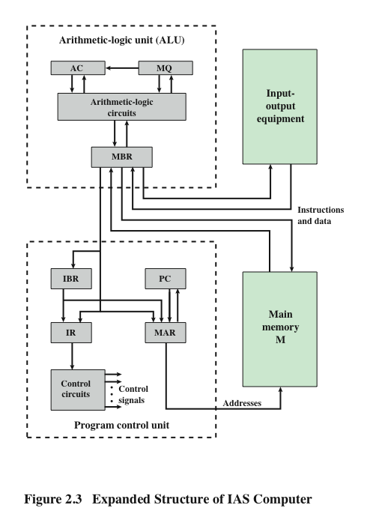
Structure of IAS Computer
The control unit operates the IAS by fetching instructions from memory and executing them one at a time.
This figure reveals that both the control unit and the ALU contain storage locations, called registers.

Slide 21
Registers
Memory buffer register (MBR)
Contains a word to be stored in memory or sent to the I/O unit
Or is used to receive a word from memory or from the I/O unit
Memory address register (MAR)
Specifies the address in memory of the word to be written from or read into the MBR
Instruction register (IR)
Contains the 8-bit opcode instruction being executed
Instruction buffer register (IBR)
Employed to temporarily hold the right-hand instruction from a word in memory
Program counter (PC)
Contains the address of the next instruction pair to be fetched from memory
Accumulator (AC) and multiplier quotient (MQ)
Employed to temporarily hold operands and results of ALU operations

Slide 22
Commercial Computers
UNIVAC
1947 – Eckert and Mauchly formed the Eckert-Mauchly Computer Corporation to manufacture computers commercially
UNIVAC I (Universal Automatic Computer)
First successful commercial computer
Was intended for both scientific and commercial applications
Commissioned by the US Bureau of Census for 1950 calculations
The Eckert-Mauchly Computer Corporation became part of the UNIVAC division of the Sperry-Rand Corporation
UNIVAC II – delivered in the late 1950’s
Had greater memory capacity and higher performance
Backward compatible

Slide 23
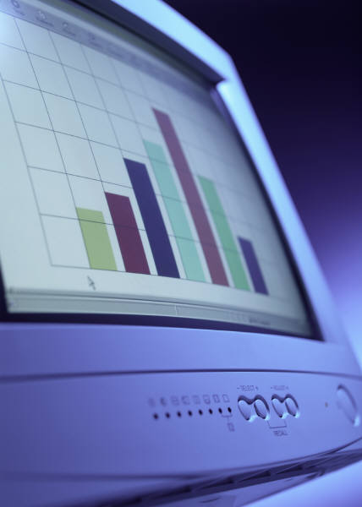

IBM
Was the major manufacturer of punched-card processing equipment
Delivered its first electronic stored-program computer (701) in 1953
Intended primarily for scientific applications
Introduced 702 product in 1955
Hardware features made it suitable to business applications
Series of 700/7000 computers established IBM as the overwhelmingly dominant computer manufacturer

Slide 24
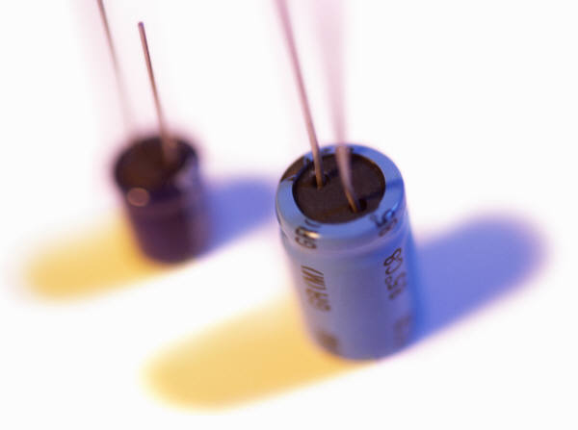
History of Computers
Second Generation: Transistors
The first major change in the electronic computer came with the replacement of the vacuum tube by the transistor.
Smaller and Cheaper
Dissipates less heat than a vacuum tube
Is a solid state device made from silicon
Was invented at Bell Labs in 1947
It was not until the late 1950’s that fully transistorized computers were commercially available

Slide 25
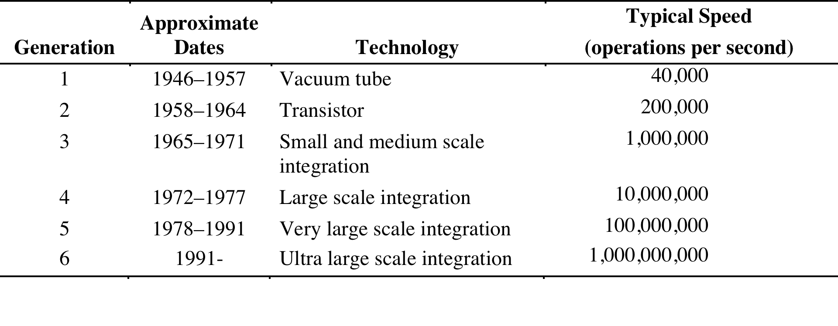
Computer Generations
Table 2.2
Computer Generations

Slide 26
Second Generation Computers
Introduced:
More complex arithmetic and logic units and control units
The use of high-level programming languages
Provision of system software which provided the ability to:
load programs
move data to peripherals and libraries
perform common computations
Appearance of the Digital Equipment Corporation (DEC) in 1957
PDP-1(Programmed Data Processor-1) was DEC’s first computer
This began the mini-computer phenomenon that would become so prominent in the third generation

Slide 27
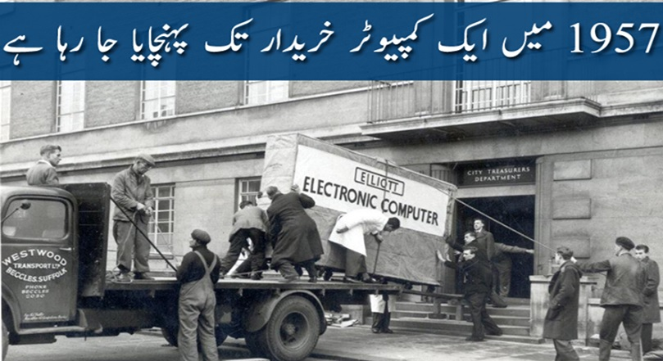
Elliott Brothersکمپیوٹر، جسے خریدنے کے لیے لندن کی ایک کمپنی Elliott سے 1955 میں مذاکرات کا آغاز کیا گیا، اسے خریدنے کا آرڈر جنوری 1956 میں دیا گیا جبکہ یہ فروری 1957 میں خریدار کو پہنچایا گیا۔ پھر اس کمپیوٹر نے اپریل 1957 میں کام کا آغاز کیا۔ کمپیوٹر کے پہلی دفعہ کام کرنے کی تقریب 3 اپریل 1957 کو ہوئی جس میں شہیر کے میئر اور پریس کو بھی مدعو کیا گیا تھا۔

Slide 28
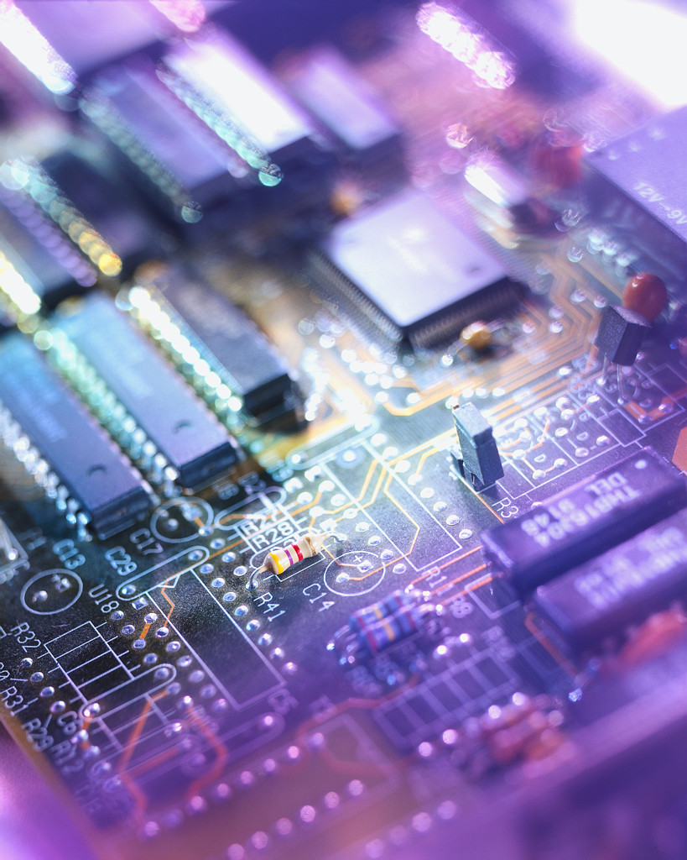
History of Computers
Third Generation: Integrated Circuits
1958 – the invention of the integrated circuit
Discrete component
Single, self-contained transistor
Manufactured separately, packaged in their own containers, and soldered or wired together onto masonite-like circuit boards
Manufacturing process was expensive and cumbersome
The two most important members of the third generation were the IBM System/360 and the DEC PDP-8
Notes:
.

Slide 29
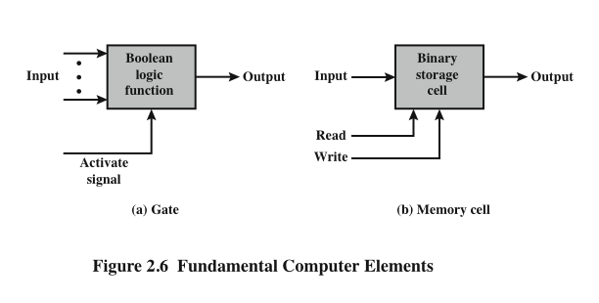
Microelectronics Small electronics, literally

Slide 30
Integrated Circuits
A computer consists of gates, memory cells, and interconnections among these elements
The gates and memory cells are constructed of simple digital electronic components
Data storage – provided by memory cells
Data processing – provided by gates
Data movement – the paths among components are used to move data from memory to memory and from memory through gates to memory
Control – the paths among components can carry control signals
Exploits the fact that such components as transistors, resistors, and conductors can be fabricated from a semiconductor such as silicon
Many transistors can be produced at the same time on a single wafer of silicon
Transistors can be connected with a processor metallization to form circuits

Slide 31
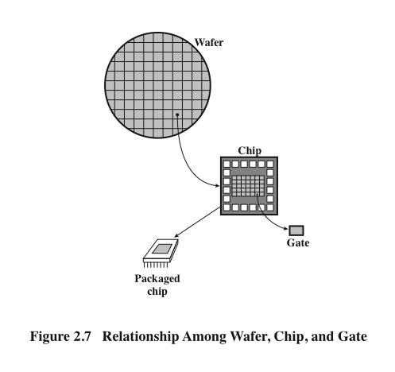
Wafer, Chip, and Gate Relationship
A thin wafer of silicon is divided into a matrix of small areas, each a few millimeters square. The identical circuit pattern is fabricated in each area, and the wafer is broken up into chips. Each chip consists of many gates and/or memory cells plus a number of input and output attachment points. This chip is then packaged in housing that protects it and provides pins for attachment to devices beyond the chip. A number of these packages can then be interconnected on a printed circuit board to produce larger and more complex circuits.

Slide 32
Moore’s Law
1965; Gordon Moore – co-founder of Intel
Observed number of transistors that could be put on a single chip was doubling every year
The pace slowed to a doubling every 18 months in the 1970’s but has sustained that rate ever since
Consequences of Moore’s law:
The cost of computer logic and memory circuitry has fallen at a dramatic rate
The electrical path length is shortened, increasing operating speed
Computer becomes smaller and is more convenient to use in a variety of environments
Reduction in power and cooling requirements
Fewer interchip connections

Slide 33

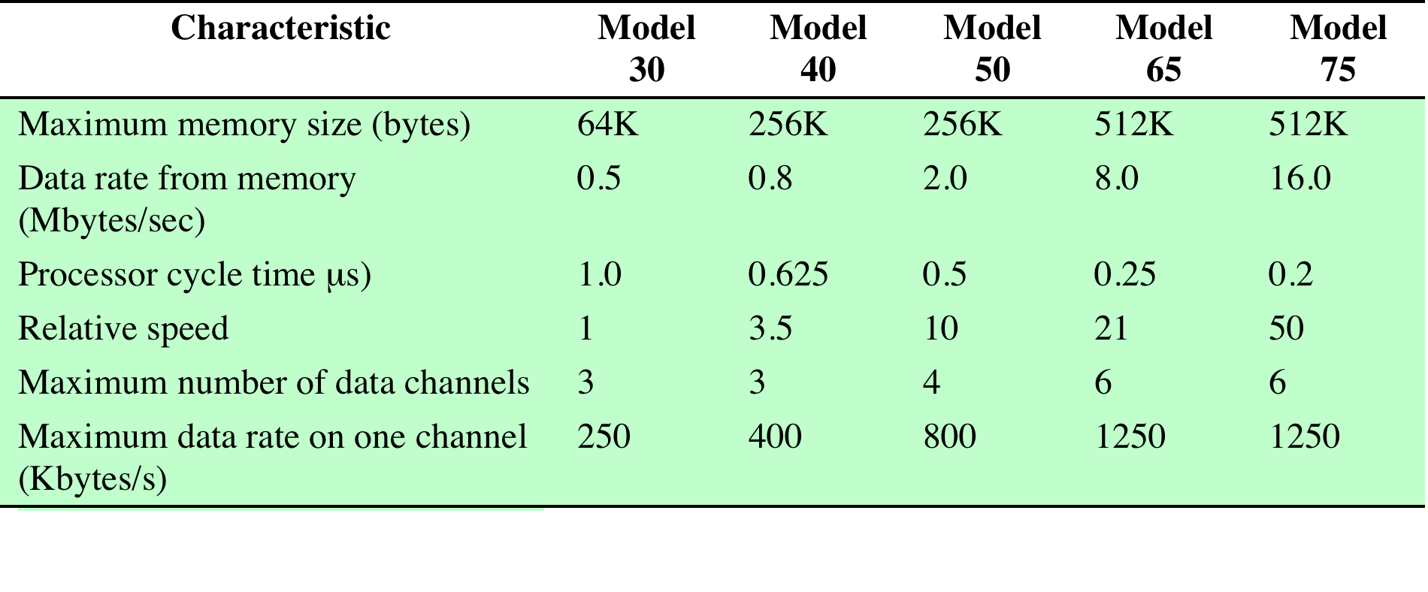
Table 2.4 Characteristics of the IBM System/360 Family
Table 2.4 Characteristics of the System/360 Family

Slide 34
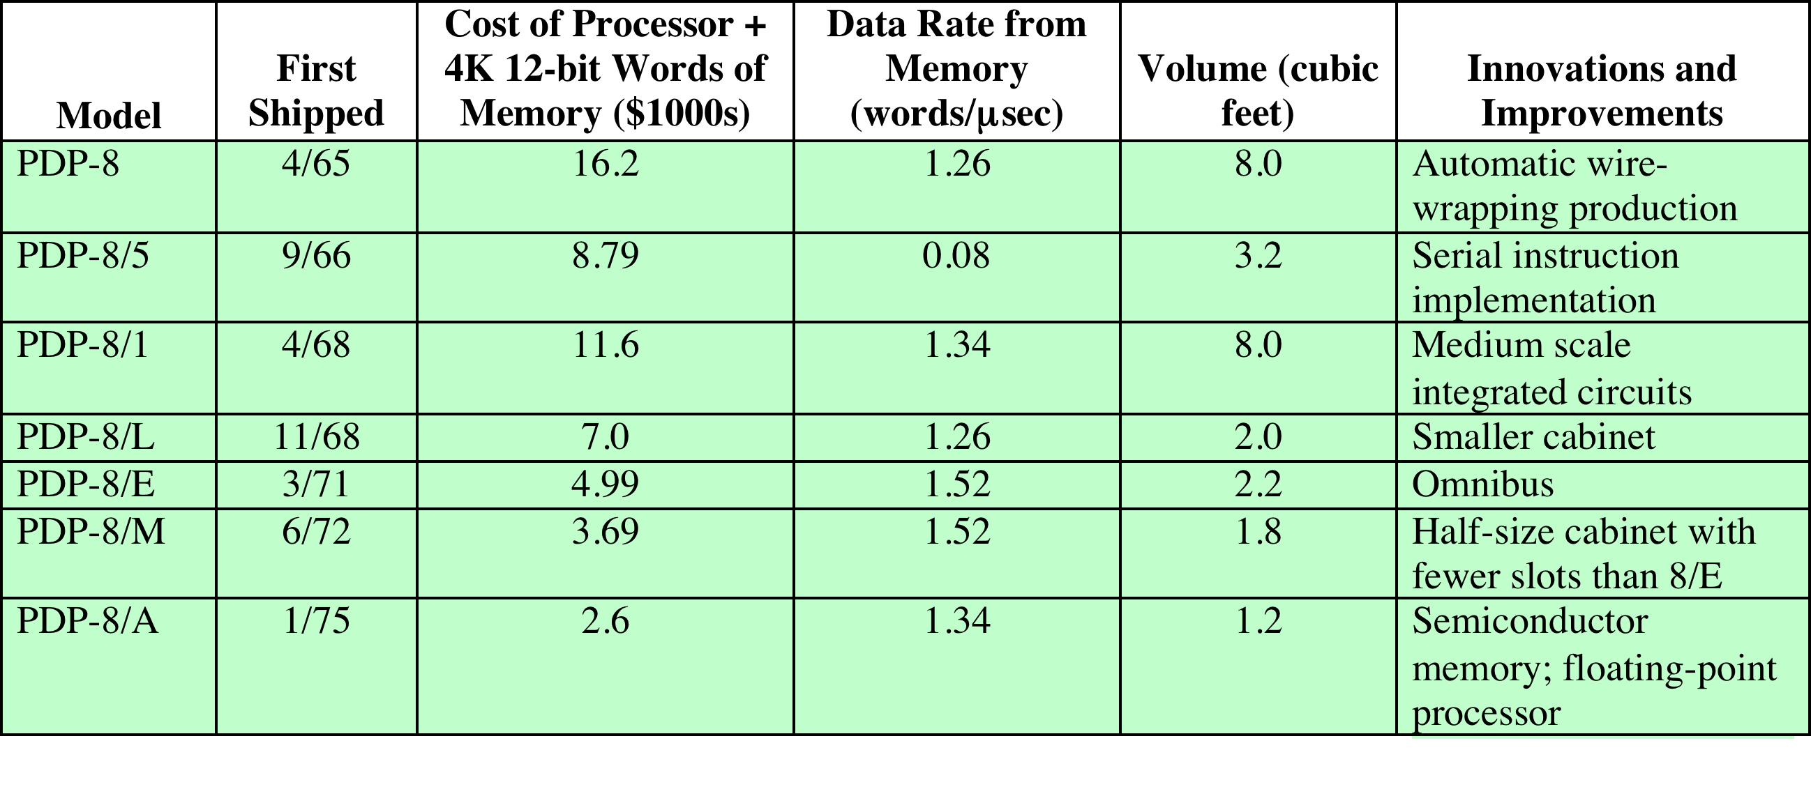
Table 2.5 Evolution of the DEC’s PDP-8
Table 2.5 Evolution of the PDP-8

Slide 35
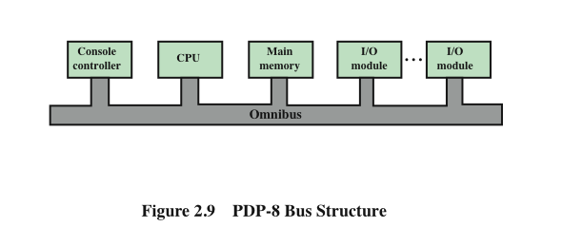
DEC - PDP-8 Bus Structure
The PDP-8 bus, called the Omnibus, consists of 96 separate signal paths, used to carry control, address, and data signals. Because all system components share a common set of signal paths, their use can be controlled by the CPU.
This architecture is highly flexible, allowing modules to be plugged into the bus to create various configurations.

Slide 36
Semiconductor Memory Microprocessors
LSI
Large Scale Integration more than 1000 components can be placed on a single integrated circuit chip
Later
Generations
VLSI
Very Large Scale Integration
10,000 components
ULSI
Ultra Large
Scale
Integration
more than one billion components

Slide 37
Semiconductor Memory
In 1970 Fairchild produced the first relatively capacious semiconductor memory
Chip was about the size of a single core
Could hold 256 bits of memory
Non-destructive
Much faster than core
In 1974 the price per bit of semiconductor memory dropped below the price per bit of core memory
There has been a continuing and rapid decline in memory cost accompanied by a corresponding increase in physical memory density
Developments in memory and processor technologies changed the nature of computers in less than a decade
Since 1970 semiconductor memory has been through 13 generations
1K, 4K, 16K, 64K, 256K, 1M, 4M, 16M, 64M, 256M, 1G, 4G, 16G on a single chip
Each generation has provided four times the storage density of the previous generation, accompanied by declining cost per bit and declining access time

Slide 38
Microprocessors
The density of elements on processor chips continued to rise
More and more elements were placed on each chip so that fewer and fewer chips were needed to construct a single computer processor
1971 Intel developed 4004
First chip to contain all of the components of a CPU on a single chip
Birth of microprocessor
1972 Intel developed 8008
First 8-bit microprocessor
1974 Intel developed 8080
First general purpose microprocessor
Faster, has a richer instruction set, has a large addressing capability

Slide 39
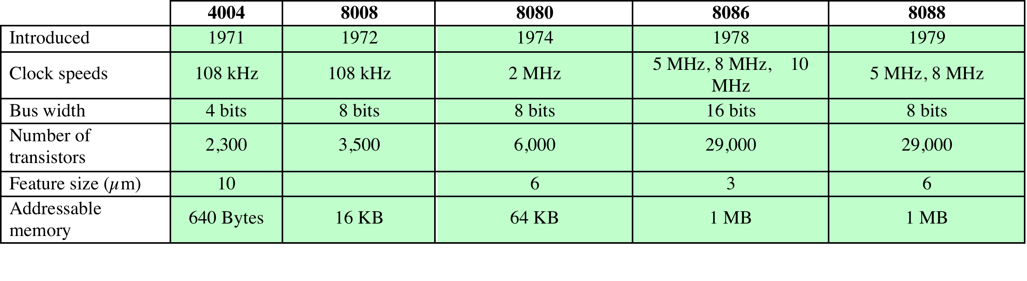
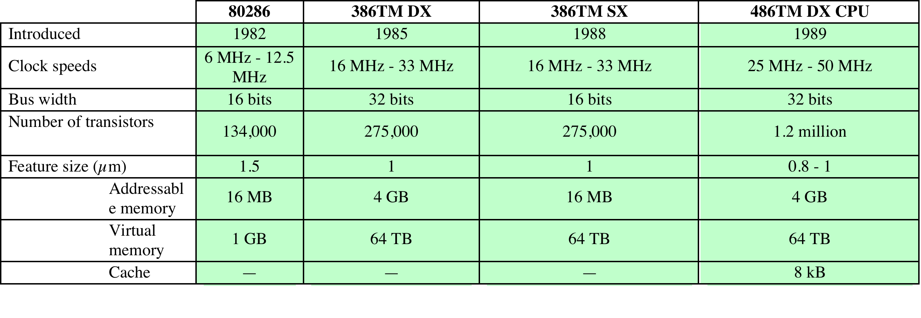
Evolution of Intel Microprocessors
a. 1970s Processors
b. 1980s Processors

Slide 40
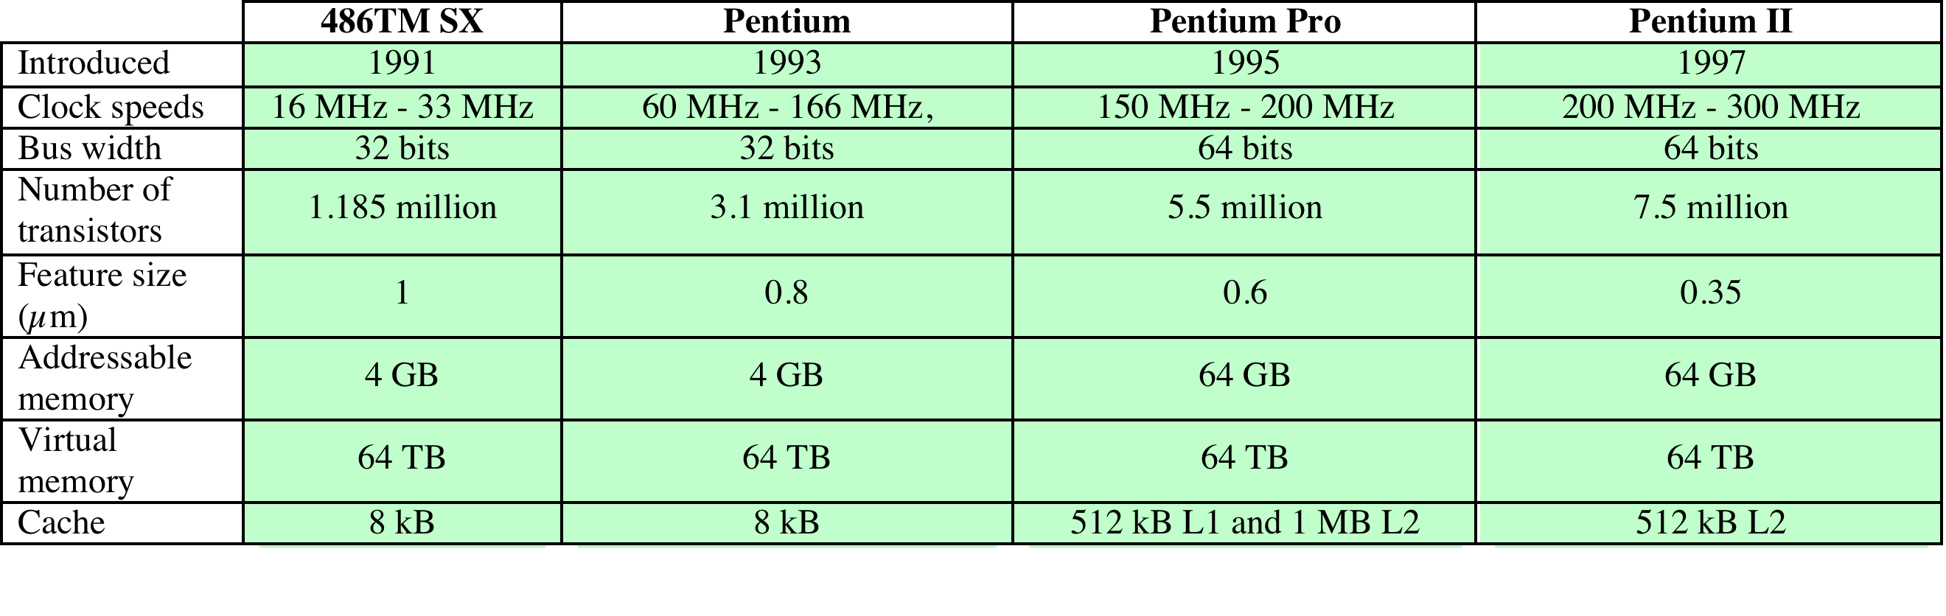
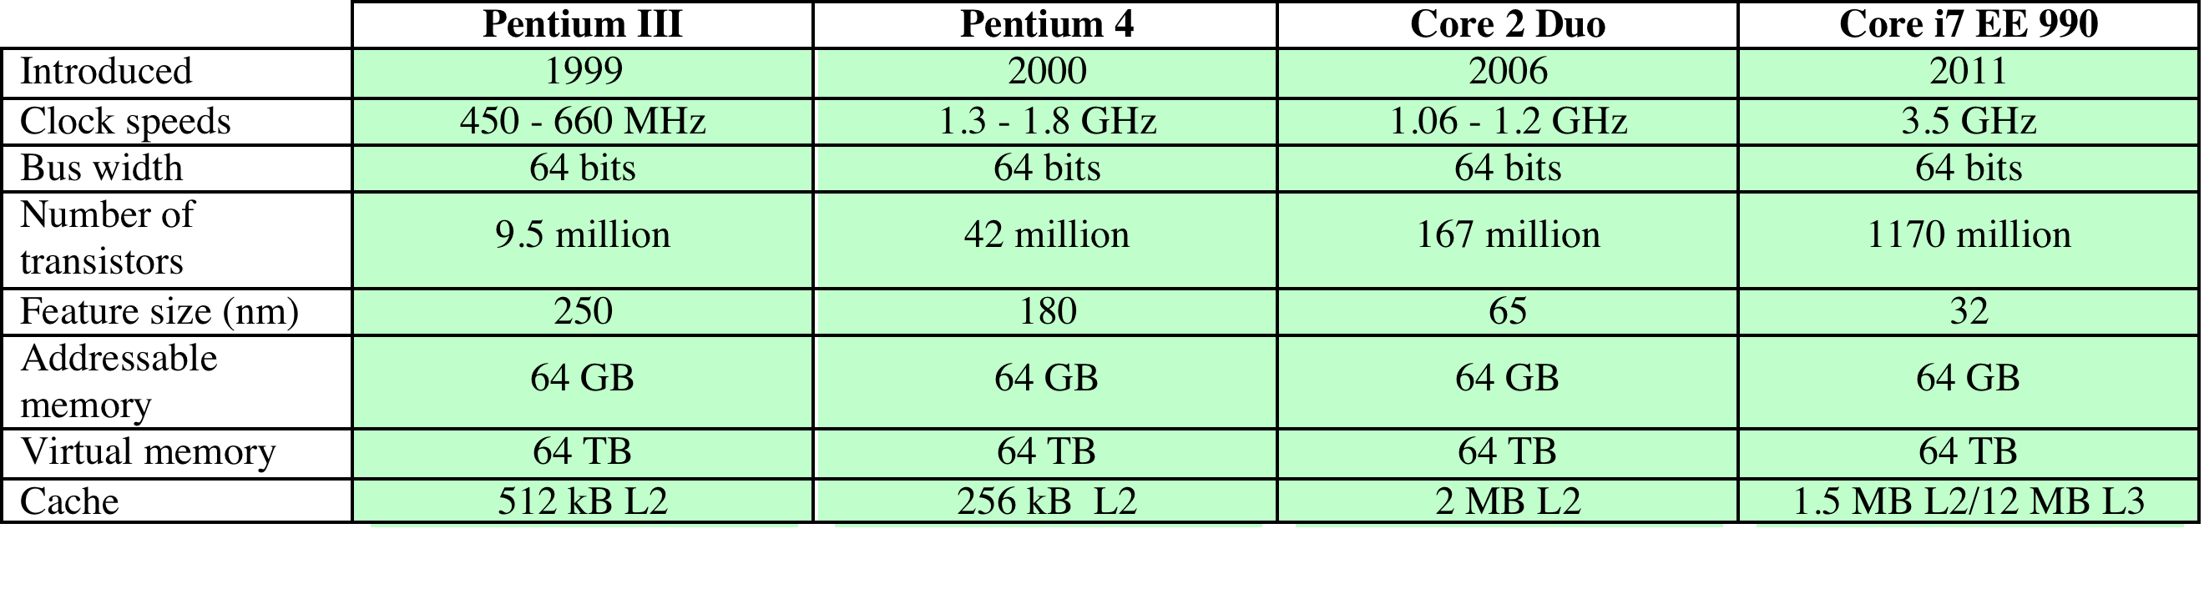
Evolution of Intel Microprocessors
c. 1990s Processors
d. Recent Processors

Slide 41
Microprocessor Speed
Techniques built into contemporary processors include:
Pipelining
Processor moves data or instructions into a conceptual pipe with all stages of the pipe processingsimultaneously on multiple instructions. For example, while one instruction is being executed, the computer is decoding the next instruction.
Branch prediction
Processor looks ahead in the instruction code fetched from memory and predicts which branches, or groups of instructions, are likely to be processed next
Data flow analysis
Processor analyzes which instructions are dependent on each other’s results, or data, to create an optimized schedule ofinstructions. This prevents unnecessary delay.
Speculative execution
Using branch prediction and data flow analysis, some processors speculatively execute instructions ahead of their actual appearance in the program execution, holding the results in temporary locations, keeping execution engines as busy as possible

Slide 42
Multicore
The use of multiple processors on the same chip provides the potential to increase performance without increasing the clock rate
Strategy is to use two simpler processors on the chip rather than one more complex processor
With two processors larger caches are justified
As caches became larger it made performance sense to create two and then three levels of cache on a chip

Slide 43
x86 Architecture
Overview
ARM
Results of decades of design effort on complex instruction set computers (CISCs)
Excellent example of CISC design
Incorporates the sophisticated design principles once found only on mainframes and supercomputers
An alternative approach to processor design is the reduced instruction set computer (RISC)
The ARM architecture is used in a wide variety of embedded systems and is one of the most powerful and best designed RISC based systems on the market
In terms of market share Intel is ranked as the number one maker of microprocessors for non-embedded systems
Intel
CISC
RISC

Slide 44
x86 Evolution
8080
First general purpose microprocessor
8-bit machine with an 8-bit data path to memory
Used in the first personal computer (Altair)
8086
16-bit machine
Used an instruction cache, or queue
First appearance of the x86 architecture
8088
used in IBM’s first personal computer
80286
Enabled addressing a 16-MByte memory instead of just 1 MByte
80386
Intel’s first 32-bit machine
First Intel processor to support multitasking
80486
More sophisticated cache technology and instruction pipelining
Built-in math coprocessor

Slide 45
x86 Evolution - Pentium
Pentium
Superscalar
Multiple instructions executed in parallel
Pentium Pro
Increased superscalar organization
Aggressive register renaming
Branch prediction
Data flow analysis
Speculative execution
Pentium II
MMX (Multimedia Extension) technology
Designed specifically to process video, audio, and graphics data
Pentium III
Additional floating-point instructions to support 3D graphics software
Pentium 4
Includes additional floating-point and other enhancements for multimedia

Slide 46
x86 Evolution (continued)
Core
First Intel x86 microprocessor with a dual core, referring to the implementation of two processors on a single chip
Core 2
Extends the architecture to 64 bits
Recent Core offerings have up to 10 processors per chip
Instruction set architecture is backward compatible with earlier versions
X86 architecture continues to dominate the processor market outside of embedded systems

Slide 47

General definition:
“A combination of computer
hardware and software, and perhaps additional mechanical or other parts, designed to perform a dedicated function. In many cases, embedded systems are part of a larger system or product, as in the case of an antilock braking system in a car.”
Embedded
Systems

Slide 48
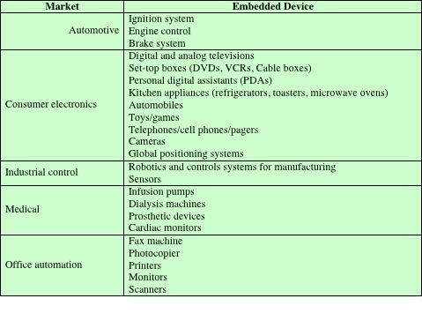
Table 2.7 Examples of Embedded Systems and Their Markets
Notes:
2.7).

